Slide 1
Chapter 13
Concurrency

Slide 2
Chapter 13 Topics
Introduction
Introduction to Subprogram-Level Concurrency
Semaphores
Monitors
Message Passing
Ada support for Concurrency
Java Threads
C# Threads
Concurrency in Functional Languages
Statement-Level Concurrency
Copyright © 2017 Pearson Education, Ltd. All rights reserved.
1-<number>

Slide 3
Introduction
Concurrency can occur at four levels:
  Machine instruction level
  High-level language statement level
  Unit level
  Program level
Because there are no language issues in instruction- and program-level concurrency, they are not addressed here
Copyright © 2017 Pearson Education, Ltd. All rights reserved.
1-<number>

Slide 4
Multiprocessor Architectures
Late 1950s - one general-purpose processor and one or more special-purpose processors for input and output operations
Early 1960s - multiple complete processors, used for program-level concurrency
Mid-1960s - multiple partial processors, used for instruction-level concurrency
Single-Instruction Multiple-Data (SIMD) machines
Multiple-Instruction Multiple-Data (MIMD) machines
A primary focus of this chapter is shared memory MIMD machines (multiprocessors)
Copyright © 2017 Pearson Education, Ltd. All rights reserved.
1-<number>

Slide 5
Categories of Concurrency
Categories of Concurrency:
  Physical concurrency - Multiple independent processors ( multiple threads of control)
  Logical concurrency - The appearance of physical concurrency is presented by time-sharing one processor (software can be designed as if there were multiple threads of control)
Coroutines (quasi-concurrency) have a single thread of control
A thread of control in a program is the sequence of program points reached as control flows through the program
Copyright © 2017 Pearson Education, Ltd. All rights reserved.
1-<number>

Slide 6
Motivations for the Use of Concurrency
Multiprocessor computers capable of physical concurrency are now widely used
Even if a machine has just one processor, a program written to use concurrent execution can be faster than the same program written for nonconcurrent execution
Involves a different way of designing software that can be very useful—many real-world situations involve concurrency
Many program applications are now spread over multiple machines, either locally or over a network
Copyright © 2017 Pearson Education, Ltd. All rights reserved.
1-<number>

Slide 7
Introduction to Subprogram-Level Concurrency
A task or process or thread is a program unit that can be in concurrent execution with other program units
Tasks differ from ordinary subprograms in that:
  A task may be implicitly started
  When a program unit starts the execution of a task, it is not necessarily suspended
  When a task’s execution is completed, control may not return to the caller
Tasks usually work together
Copyright © 2017 Pearson Education, Ltd. All rights reserved.
1-<number>

Slide 8
Two General Categories of Tasks
Heavyweight tasks execute in their own address space
Lightweight tasks all run in the same address space – more efficient
A task is disjoint if it does not communicate with or affect the execution of any other task in the program in any way
Copyright © 2017 Pearson Education, Ltd. All rights reserved.
1-<number>

Slide 9
Task Synchronization
A mechanism that controls the order in which tasks execute
Two kinds of synchronization
  Cooperation synchronization
  Competition synchronization
Task communication is necessary for synchronization, provided by:
- Shared nonlocal variables
- Parameters
- Message passing
Copyright © 2017 Pearson Education, Ltd. All rights reserved.
1-<number>

Slide 10
Kinds of synchronization
Cooperation: Task A must wait for task B to complete some specific activity before task A can continue its execution, e.g., the producer-consumer problem
Competition: Two or more tasks must use some resource that cannot be simultaneously used, e.g., a shared counter
  Competition is usually provided by mutually exclusive access (approaches are discussed later)
Copyright © 2017 Pearson Education, Ltd. All rights reserved.
1-<number>

Slide 11
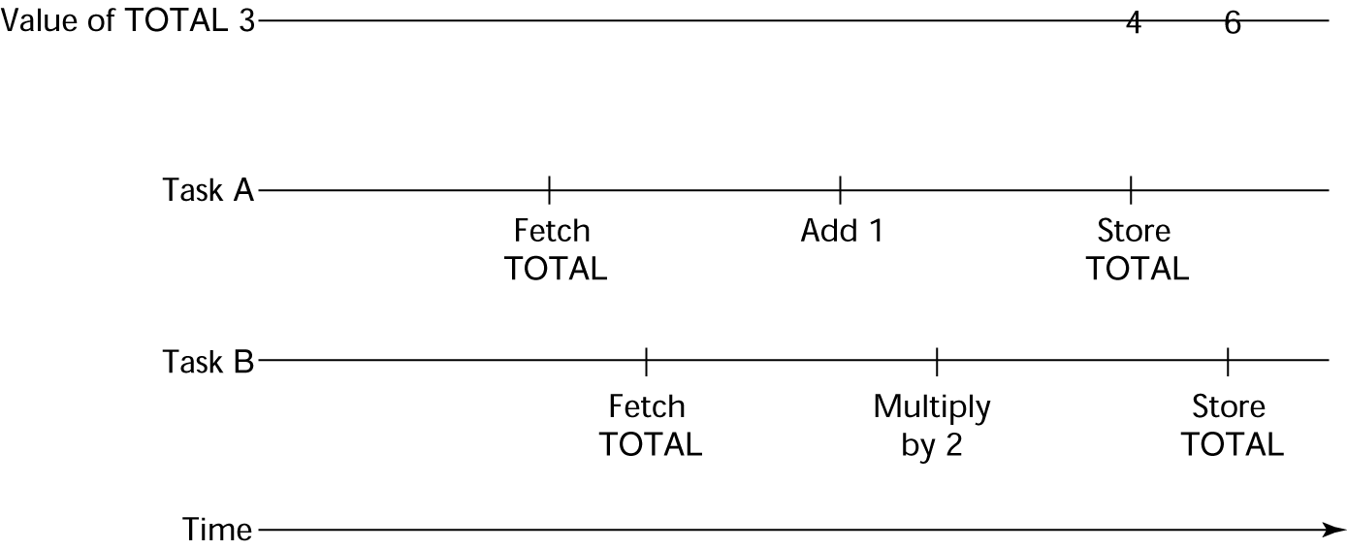
Need for Competition Synchronization
Task A: TOTAL = TOTAL + 1
Task B: TOTAL = 2 * TOTAL
- Depending on order, there could be four different results
Copyright © 2017 Pearson Education, Ltd. All rights reserved.
1-<number>

Slide 12
Scheduler
Providing synchronization requires a mechanism for delaying task execution
Task execution control is maintained by a program called the scheduler, which maps task execution onto available processors
Copyright © 2017 Pearson Education, Ltd. All rights reserved.
1-<number>

Slide 13
Task Execution States
New - created but not yet started
Ready - ready to run but not currently running (no available processor)
Running
Blocked - has been running, but cannot now continue (usually waiting for some event to occur)
Dead - no longer active in any sense
Copyright © 2017 Pearson Education, Ltd. All rights reserved.
1-<number>

Slide 14
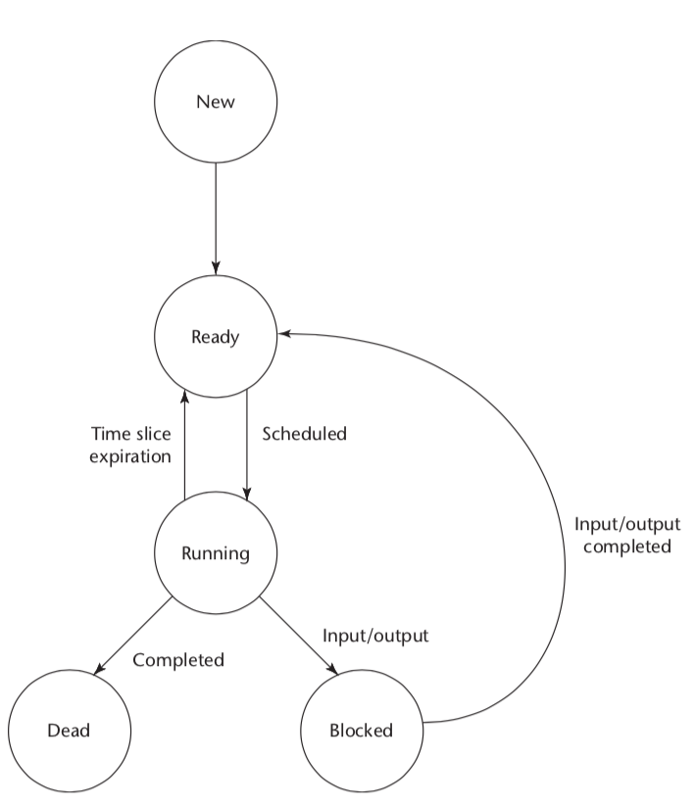
Task Execution States (continued)
Copyright © 2017 Pearson Education, Ltd. All rights reserved.
1-<number>

Slide 15
Liveness and Deadlock
Liveness is a characteristic that a program unit may or may not have
- In sequential code, it means the unit will
eventually complete its execution
In a concurrent environment, a task can easily lose its liveness
If all tasks in a concurrent environment lose their liveness, it is called deadlock
Copyright © 2017 Pearson Education, Ltd. All rights reserved.
1-<number>

Slide 16
Design Issues for Concurrency
Competition and cooperation synchronization*
Controlling task scheduling
How can an application influence task scheduling
How and when tasks start and end execution
How and when are tasks created
* The most important issue
Copyright © 2017 Pearson Education, Ltd. All rights reserved.
1-<number>

Slide 17
Methods of Providing Synchronization
Semaphores
Monitors
Message Passing
Copyright © 2017 Pearson Education, Ltd. All rights reserved.
1-<number>

Slide 18
Semaphores
Dijkstra - 1965
A semaphore is a data structure consisting of a counter and a queue for storing task descriptors
  A task descriptor is a data structure that stores all of the relevant information about the execution state of the task
Semaphores can be used to implement guards on the code that accesses shared data structures
Semaphores have only two operations, wait and release (originally called P and V by Dijkstra)
Semaphores can be used to provide both competition and cooperation synchronization
Copyright © 2017 Pearson Education, Ltd. All rights reserved.
1-<number>

Slide 19
Cooperation Synchronization with Semaphores
Example: A shared buffer
The buffer is implemented as an ADT with the operations DEPOSIT and FETCH as the only ways to access the buffer
Use two semaphores for cooperation: emptyspots and fullspots
The semaphore counters are used to store the numbers of empty spots and full spots in the buffer
Copyright © 2017 Pearson Education, Ltd. All rights reserved.
1-<number>

Slide 20
Cooperation Synchronization with Semaphores (continued)
DEPOSIT must first check emptyspots to see if there is room in the buffer
If there is room, the counter of emptyspots is decremented and the value is inserted
If there is no room, the caller is stored in the queue of emptyspots
When DEPOSIT is finished, it must increment the counter of fullspots
Copyright © 2017 Pearson Education, Ltd. All rights reserved.
1-<number>

Slide 21
Cooperation Synchronization with Semaphores (continued)
FETCH must first check fullspots to see if there is a value
  If there is a full spot, the counter of fullspots is decremented and the value is removed
  If there are no values in the buffer, the caller must be placed in the queue of fullspots
  When FETCH is finished, it increments the counter of emptyspots
The operations of FETCH and DEPOSIT on the semaphores are accomplished through two semaphore operations named wait and release
Copyright © 2017 Pearson Education, Ltd. All rights reserved.
1-<number>

Slide 22
Semaphores: Wait and Release Operations
wait(aSemaphore)
if aSemaphore’s counter > 0 then
decrement aSemaphore’s counter
else
put the caller in aSemaphore’s queue
attempt to transfer control to a ready task
-- if the task ready queue is empty,
-- deadlock occurs
end
release(aSemaphore)
if aSemaphore’s queue is empty then
increment aSemaphore’s counter
else
put the calling task in the task ready queue
transfer control to a task from aSemaphore’s queue
end
Copyright © 2017 Pearson Education, Ltd. All rights reserved.
1-<number>

Slide 23
Producer and Consumer Tasks
semaphore fullspots, emptyspots;
fullstops.count = 0;
emptyspots.count = BUFLEN;
task producer;
loop
-- produce VALUE –-
wait (emptyspots); {wait for space}
DEPOSIT(VALUE);
release(fullspots); {increase filled}
end loop;
end producer;
task consumer;
loop
wait (fullspots);{wait till not empty}}
FETCH(VALUE);
release(emptyspots); {increase empty}
-- consume VALUE –-
end loop;
end consumer;
Copyright © 2017 Pearson Education, Ltd. All rights reserved.
1-<number>

Slide 24
Competition Synchronization with Semaphores
A third semaphore, named access, is used to control access (competition synchronization)
  The counter of access will only have the values 0 and 1
  Such a semaphore is called a binary semaphore
Note that wait and release must be atomic!
Copyright © 2017 Pearson Education, Ltd. All rights reserved.
1-<number>

Slide 25
Producer Code for Semaphores
semaphore access, fullspots, emptyspots;
access.count = 0;
fullstops.count = 0;
emptyspots.count = BUFLEN;
task producer;
loop
-- produce VALUE –-
wait(emptyspots); {wait for space}
wait(access); {wait for access)
DEPOSIT(VALUE);
release(access); {relinquish access}
release(fullspots); {increase filled}
end loop;
end producer;
Copyright © 2017 Pearson Education, Ltd. All rights reserved.
1-<number>

Slide 26
Consumer Code for Semaphores
task consumer;
loop
wait(fullspots);{wait till not empty}
wait(access); {wait for access}
FETCH(VALUE);
release(access); {relinquish access}
release(emptyspots); {increase empty}
-- consume VALUE –-
end loop;
end consumer;
Copyright © 2017 Pearson Education, Ltd. All rights reserved.
1-<number>

Slide 27
Evaluation of Semaphores
Misuse of semaphores can cause failures in cooperation synchronization, e.g., the buffer will overflow if the wait of fullspots is left out
Misuse of semaphores can cause failures in competition synchronization, e.g., the program will deadlock if the release of access is left out
Copyright © 2017 Pearson Education, Ltd. All rights reserved.
1-<number>

Slide 28
Monitors
Ada, Java, C#
The idea: encapsulate the shared data and its operations to restrict access
A monitor is an abstract data type for shared data
Copyright © 2017 Pearson Education, Ltd. All rights reserved.
1-<number>

Slide 29
Competition Synchronization
Shared data is resident in the monitor (rather than in the client units)
All access resident in the monitor
  Monitor implementation guarantee synchronized access by allowing only one access at a time
  Calls to monitor procedures are implicitly queued if the monitor is busy at the time of the call
Copyright © 2017 Pearson Education, Ltd. All rights reserved.
1-<number>

Slide 30
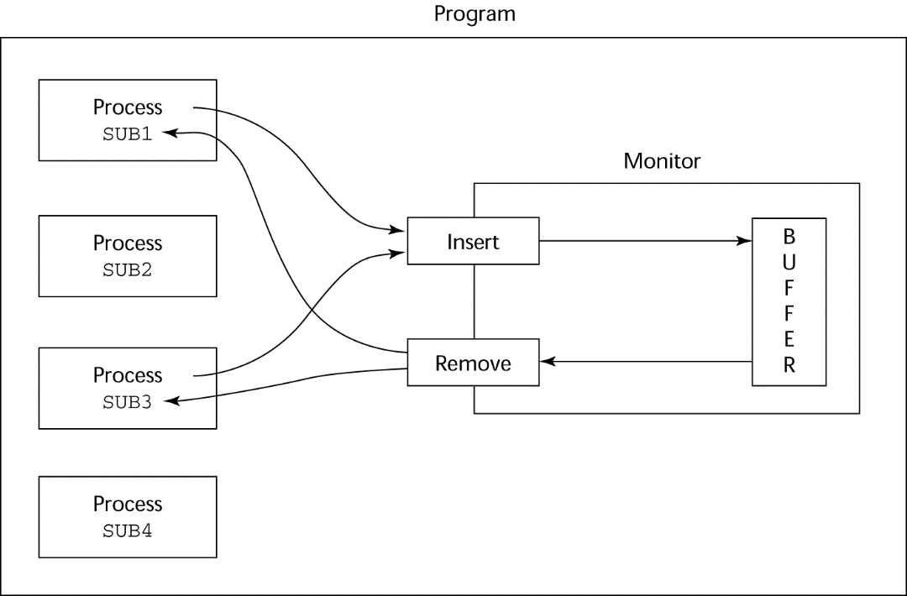
Cooperation Synchronization
Cooperation between processes is still a programming task
  Programmer must guarantee that a shared buffer does not experience underflow or overflow
Copyright © 2017 Pearson Education, Ltd. All rights reserved.
1-<number>

Slide 31
Evaluation of Monitors
A better way to provide competition synchronization than are semaphores
Semaphores can be used to implement monitors
Monitors can be used to implement semaphores
Support for cooperation synchronization is very similar as with semaphores, so it has the same problems
Copyright © 2017 Pearson Education, Ltd. All rights reserved.
1-<number>

Slide 32
Message Passing
Message passing is a general model for concurrency
  It can model both semaphores and monitors
  It is not just for competition synchronization
Central idea: task communication is like seeing a doctor--most of the time she waits for you or you wait for her, but when you are both ready, you get together, or rendezvous
Copyright © 2017 Pearson Education, Ltd. All rights reserved.
1-<number>

Slide 33
Message Passing Rendezvous
To support concurrent tasks with message passing, a language needs:
- A mechanism to allow a task to indicate when it is willing to accept messages
- A way to remember who is waiting to have its message accepted and some “fair” way of choosing the next message
When a sender task’s message is accepted by a receiver task, the actual message transmission is called a rendezvous
Copyright © 2017 Pearson Education, Ltd. All rights reserved.
1-<number>

Slide 34
Ada Support for Concurrency
The Ada 83 Message-Passing Model
  Ada tasks have specification and body parts, like packages; the spec has the interface, which is the collection of entry points:
  task Task_Example is
  entry ENTRY_1 (Item : in Integer);
  end Task_Example;
Copyright © 2017 Pearson Education, Ltd. All rights reserved.
1-<number>

Slide 35
Task Body
The body task describes the action that takes place when a rendezvous occurs
A task that sends a message is suspended while waiting for the message to be accepted and during the rendezvous
Entry points in the spec are described with accept clauses in the body
  accept entry_name (formal parameters) do
  ...
  end entry_name;
Copyright © 2017 Pearson Education, Ltd. All rights reserved.
1-<number>

Slide 36
Example of a Task Body
task body Task_Example is
begin
loop
accept Entry_1 (Item: in Float) do
...
end Entry_1;
end loop;
end Task_Example;
Copyright © 2017 Pearson Education, Ltd. All rights reserved.
1-<number>

Slide 37
Ada Message Passing Semantics
The task executes to the top of the accept clause and waits for a message
During execution of the accept clause, the sender is suspended
accept parameters can transmit information in either or both directions
Every accept clause has an associated queue to store waiting messages
Copyright © 2017 Pearson Education, Ltd. All rights reserved.
1-<number>

Slide 38
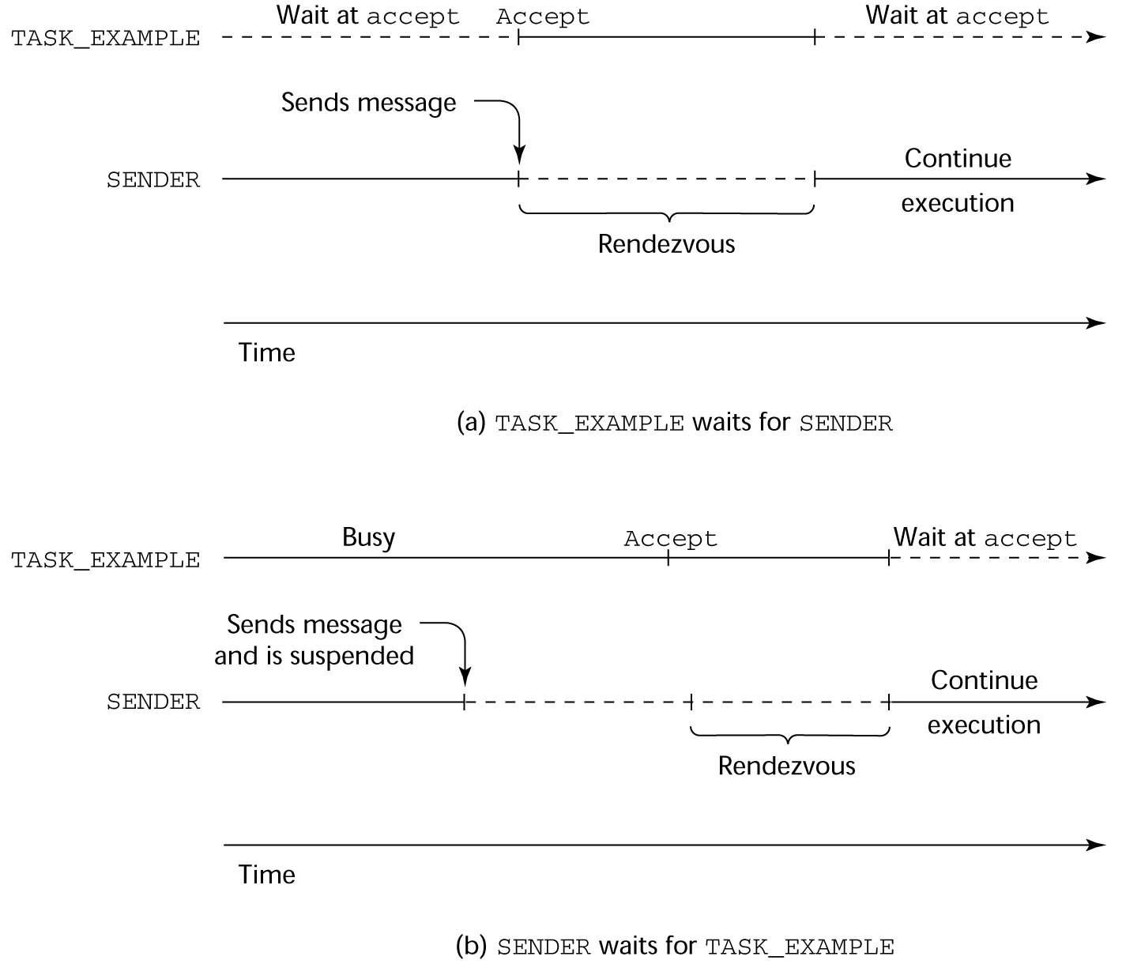
Rendezvous Time Lines
Copyright © 2017 Pearson Education, Ltd. All rights reserved.
1-<number>

Slide 39
Message Passing: Server/Actor Tasks
A task that has accept clauses, but no other code is called a server task (the example above is a server task)
A task without accept clauses is called an actor task
  An actor task can send messages to other tasks
  Note: A sender must know the entry name of the receiver, but not vice versa (asymmetric)
Copyright © 2017 Pearson Education, Ltd. All rights reserved.
1-<number>

Slide 40
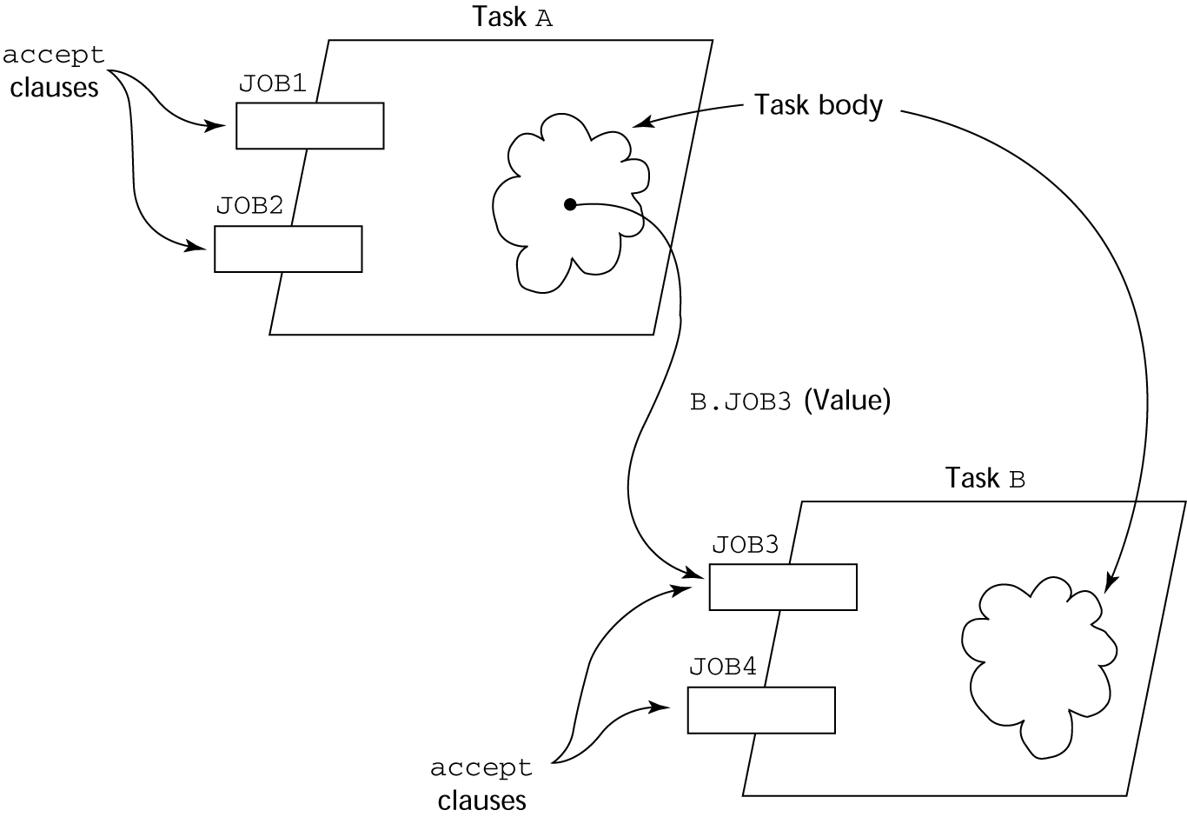
Graphical Representation of a Rendezvous
Copyright © 2017 Pearson Education, Ltd. All rights reserved.
1-<number>

Slide 41
Multiple Entry Points
Tasks can have more than one entry point
  The specification task has an entry clause for each
  The task body has an accept clause for each entry clause, placed in a select clause, which is in a loop
Copyright © 2017 Pearson Education, Ltd. All rights reserved.
1-<number>

Slide 42
A Task with Multiple Entries
  task body Teller is
loop
select
accept Drive_Up(formal params) do
...
end Drive_Up;
...
or
accept Walk_Up(formal params) do
...
end Walk_Up;
...
end select;
end loop;
end Teller;
Copyright © 2017 Pearson Education, Ltd. All rights reserved.
1-<number>

Slide 43
Semantics of Tasks with Multiple accept Clauses
If exactly one entry queue is nonempty, choose a message from it
If more than one entry queue is nonempty, choose one, nondeterministically, from which to accept a message
If all are empty, wait
The construct is often called a selective wait
Extended accept clause - code following the clause, but before the next clause
  Executed concurrently with the caller
Copyright © 2017 Pearson Education, Ltd. All rights reserved.
1-<number>

Slide 44
Cooperation Synchronization with Message Passing
Provided by Guarded accept clauses
when not Full(Buffer) =>
accept Deposit (New_Value) do
...
end
An accept clause with a with a when clause is either open or closed
  A clause whose guard is true is called open
  A clause whose guard is false is called closed
  A clause without a guard is always open
Copyright © 2017 Pearson Education, Ltd. All rights reserved.
1-<number>

Slide 45
Semantics of select with Guarded accept Clauses:
select first checks the guards on all clauses
If exactly one is open, its queue is checked for messages
If more than one are open, non-deterministically choose a queue among them to check for messages
If all are closed, it is a runtime error
A select clause can include an else clause to avoid the error
  When the else clause completes, the loop repeats
Copyright © 2017 Pearson Education, Ltd. All rights reserved.
1-<number>

Slide 46
Competition Synchronization with Message Passing
Modeling mutually exclusive access to shared data
Example--a shared buffer
Encapsulate the buffer and its operations in a task
Competition synchronization is implicit in the semantics of accept clauses
  Only one accept clause in a task can be active at any given time
Copyright © 2017 Pearson Education, Ltd. All rights reserved.
1-<number>

Slide 47
Partial Shared Buffer Code
task body Buf_Task is
Bufsize : constant Integer := 100;
Buf : array (1..Bufsize) of Integer;
Filled : Integer range 0..Bufsize := 0;
Next_In, Next_Out : Integer range 1..Bufsize := 1;
begin
loop
select
when Filled < Bufsize =>
accept Deposit(Item : in Integer) do
Buf(Next_In) := Item;
end Deposit;
Next_In := (Next_In mod Bufsize) + 1;
Filled := Filled + 1;
or
...
end loop;
end Buf_Task;
Copyright © 2017 Pearson Education, Ltd. All rights reserved.
1-<number>

Slide 48
A Consumer Task
task Consumer;
task body Consumer is
Stored_Value : Integer;
begin
loop
Buf_Task.Fetch(Stored_Value);
-- consume Stored_Value –
end loop;
end Consumer;
Copyright © 2017 Pearson Education, Ltd. All rights reserved.
1-<number>

Slide 49
Concurrency in Ada 95
Ada 95 includes Ada 83 features for concurrency, plus two new features
  Protected objects: A more efficient way of implementing shared data to allow access to a shared data structure to be done without rendezvous
  Asynchronous communication
Copyright © 2017 Pearson Education, Ltd. All rights reserved.
1-<number>

Slide 50
Ada 95: Protected Objects
A protected object is similar to an abstract data type
Access to a protected object is either through messages passed to entries, as with a task, or through protected subprograms
A protected procedure provides mutually exclusive read-write access to protected objects
A protected function provides concurrent read-only access to protected objects
Copyright © 2017 Pearson Education, Ltd. All rights reserved.
1-<number>

Slide 51
Evaluation of the Ada
Message passing model of concurrency is powerful and general
Protected objects are a better way to provide synchronized shared data
In the absence of distributed processors, the choice between monitors and tasks with message passing is somewhat a matter of taste
For distributed systems, message passing is a better model for concurrency
Copyright © 2017 Pearson Education, Ltd. All rights reserved.
1-<number>

Slide 52
Java Threads
The concurrent units in Java are methods named run
  A run method code can be in concurrent execution with other such methods
  The process in which the run methods execute is called a thread
  class myThread extends Thread
  public void run () {…}
  }
  …
  Thread myTh = new MyThread ();
  myTh.start();
Copyright © 2017 Pearson Education, Ltd. All rights reserved.
1-<number>

Slide 53
Controlling Thread Execution
The Thread class has several methods to control the execution of threads
  The yield is a request from the running thread to voluntarily surrender the processor
  The sleep method can be used by the caller of the method to block the thread
  The join method is used to force a method to delay its execution until the run method of another thread has completed its execution
Copyright © 2017 Pearson Education, Ltd. All rights reserved.
1-<number>

Slide 54
Thread Priorities
A thread’s default priority is the same as the thread that create it
  If main creates a thread, its default priority is NORM_PRIORITY
Threads defined two other priority constants, MAX_PRIORITY and MIN_PRIORITY
The priority of a thread can be changed with the methods setPriority
Copyright © 2017 Pearson Education, Ltd. All rights reserved.
1-<number>

Slide 55

Semaphores in Java
Copyright © 2017 Pearson Education, Ltd. All rights reserved.
1-<number>

Slide 56
Competition Synchronization with Java Threads
A method that includes the synchronized modifier disallows any other method from running on the object while it is in execution
  …
  public synchronized void deposit( int i) {…}
  public synchronized int fetch() {…}
  …
The above two methods are synchronized which prevents them from interfering with each other
If only a part of a method must be run without interference, it can be synchronized thru synchronized statement
  synchronized (expression)
  statement
Copyright © 2017 Pearson Education, Ltd. All rights reserved.
1-<number>

Slide 57
Cooperation Synchronization with Java Threads
Cooperation synchronization in Java is achieved via wait, notify, and notifyAll methods
  All methods are defined in Object, which is the root class in Java, so all objects inherit them
The wait method must be called in a loop
The notify method is called to tell one waiting thread that the event it was waiting has happened
The notifyAll method awakens all of the threads on the object’s wait list
Copyright © 2017 Pearson Education, Ltd. All rights reserved.
1-<number>

Slide 58
Java’s Thread Evaluation
Java’s support for concurrency is relatively simple but effective
Not as powerful as Ada’s tasks
Copyright © 2017 Pearson Education, Ltd. All rights reserved.
1-<number>

Slide 59
C# Threads
Loosely based on Java but there are significant differences
Basic thread operations
  Any method can run in its own thread
  A thread is created by creating a Thread object
  Creating a thread does not start its concurrent execution; it must be requested through the Start method
  A thread can be made to wait for another thread to finish with Join
  A thread can be suspended with Sleep
  A thread can be terminated with Abort
Copyright © 2017 Pearson Education, Ltd. All rights reserved.
1-<number>

Slide 60
Synchronizing Threads
Three ways to synchronize C# threads
  The Interlocked class
    Used when the only operations that need to be synchronized are incrementing or decrementing of an integer
  The lock statement
    Used to mark a critical section of code in a thread
    lock (expression) {… }
  The Monitor class
    Provides four methods that can be used to provide more sophisticated synchronization
Copyright © 2017 Pearson Education, Ltd. All rights reserved.
1-<number>

Slide 61
C#’s Concurrency Evaluation
An advance over Java threads, e.g., any method can run its own thread
Thread termination is cleaner than in Java
Synchronization is more sophisticated
Copyright © 2017 Pearson Education, Ltd. All rights reserved.
1-<number>

Slide 62
Statement-Level Concurrency
Objective: Provide a mechanism that the programmer can use to inform compiler of ways it can map the program onto multiprocessor architecture
Minimize communication among processors and the memories of the other processors
Copyright © 2017 Pearson Education, Ltd. All rights reserved.
1-<number>

Slide 63
High-Performance Fortran
A collection of extensions that allow the programmer to provide information to the compiler to help it optimize code for multiprocessor computers
Specify the number of processors, the distribution of data over the memories of those processors, and the alignment of data
Copyright © 2017 Pearson Education, Ltd. All rights reserved.
1-<number>

Slide 64
Primary HPF Specifications
Number of processors
!HPF$ PROCESSORS procs (n)
Distribution of data
!HPF$ DISTRIBUTE (kind) ONTO procs :: identifier_list
  kind can be BLOCK (distribute data to processors in blocks) or CYCLIC (distribute data to processors one element at a time)
Relate the distribution of one array with that of another
ALIGN array1_element WITH array2_element
Copyright © 2017 Pearson Education, Ltd. All rights reserved.
1-<number>

Slide 65
Statement-Level Concurrency Example
REAL list_1(1000), list_2(1000)
INTEGER list_3(500), list_4(501)
!HPF$ PROCESSORS proc (10)
!HPF$ DISTRIBUTE (BLOCK) ONTO procs ::
list_1, list_2
!HPF$ ALIGN list_1(index) WITH
list_4 (index+1)
…
list_1 (index) = list_2(index)
list_3(index) = list_4(index+1)
Copyright © 2017 Pearson Education, Ltd. All rights reserved.
1-<number>

Slide 66
Statement-Level Concurrency (continued)
FORALL statement is used to specify a list of statements that may be executed concurrently
FORALL (index = 1:1000)
list_1(index) = list_2(index)
Specifies that all 1,000 RHSs of the assignments can be evaluated before any assignment takes place
Copyright © 2017 Pearson Education, Ltd. All rights reserved.
1-<number>

Slide 67
Summary
Concurrent execution can be at the instruction, statement, or subprogram level
Physical concurrency: when multiple processors are used to execute concurrent units
Logical concurrency: concurrent united are executed on a single processor
Two primary facilities to support subprogram concurrency: competition synchronization and cooperation synchronization
Mechanisms: semaphores, monitors, rendezvous, threads
High-Performance Fortran provides statements for specifying how data is to be distributed over the memory units connected to multiple processors
Copyright © 2017 Pearson Education, Ltd. All rights reserved.
1-<number>

